Slide 1


2024
ELECTION JUDGE TRAINING
June, 2024

Slide 2

Training Agenda
Code of Conduct
Polling Place Set-Up
Opening the Polls
Election Judge Duties
Polling Place Conduct
Providing Assistance to Voters
Challengers
Closing the Polls

Slide 3

Election Judge Code of Conduct
You will take and sign this oath:
“I solemnly swear (or affirm) that I will perform the duties of election judge according to law and the best of my ability and will diligently endeavor to prevent fraud, deceit and abuse in conducting this election. I will perform my duties in a fair and impartial manner and not attempt to create an advantage for my party or any candidate.”
M.S. 204B.24

Slide 4
What does the code of conduct look like in practice?
Be impartial, courteous and professional
Maintain your polling place’s accessibility, neutrality, and efficiency
Enjoy assisting and serving diverse populations
Stay positive!!

Slide 5
Election Judge Neutrality in the Polling Place
Voters have the right to vote in a polling place that is free of any influence.
Remember your Oath: “I will perform my duties in a fair and impartial manner and not attempt to create an advantage for my party or my candidate.”

Slide 6
Polling Place Set-Up - Overview
Polling Place Judges:
Head Judge (a/k/a Chairperson or Chair)
Greeter Judge
Roster Judge
Registration Judge
Demonstration Judge
Ballot Judge
Ballot Counter Judge (Ballot Counter a/k/a DS200 or Voting Machine/Tabulator)

Slide 7
Head Judge (Chairperson): Duties
Lead official in the polling place
Oversees polling place setup and ensures supplies are ready before opening
Administers the election judge oath
Conducts emergency judge training for replacement judges
Reviews news media credentials
Conducts the challenge process
Resolves questions and problems
Completes election returns and other forms
Closes the polling place and returns materials

Slide 8
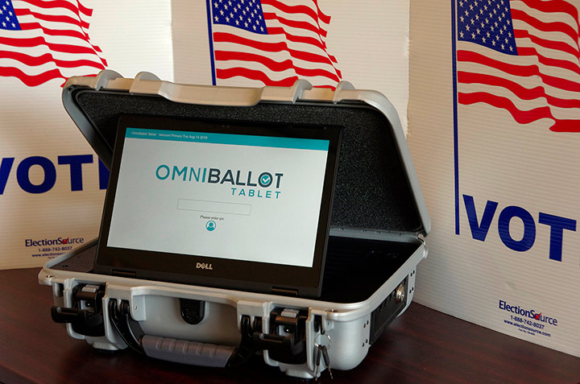
Polling Place Set-Up and Guidance for Equipment
OMNI-BALLOT (Assisted Voting Device)
Provides privacy and independence to voters who cannot, or choose not, to vote using a pen
Displays the ballot in large print or with a high-contrast background
Can read the ballot to the voter through headphones
Test your device! Compare paper ballot to offices and candidates displayed on the screen. Ensure the audio works.
Make the station private and wheelchair accessible.

Slide 9
Polling Place Set-Up - Preparing Ballots
Record the total number of ballots provided in packets. M.S. 204C.09, subd. 1(a)
Open an initial supply of packets and verify quantity
Two judges initial each ballot. M.S. 204C.09, subd. 1(b)
Call before you are about to open the 2ND TO LAST pack AND AGAIN, when you get to the last pack, if necessary.

Slide 10
Polling Place Set-Up and Guidance: Opening the Polls
Polling place opening and voting MUST begin on time.
If the Omni-Ballot is not working, contact the City Clerk’s Office immediately.
If the DS-200 is not working, use the auxiliary slot on the ballot box and contact the City Clerk’s Office immediately.

Slide 11
Roster Steps at the Roster Table
Ask for name and address
Voter may hand you an ID to assist with locating their name—this is voter’s choice and not required. Clarify verbally an ID not necessary so that those nearby are not confused.
Check page for roster notations, (e.g. “See ID”)
Hide Challenges from view except any Challenge for that voter
Point to the oath and have them sign
Give voter receipt and direct to Ballot Judge station
Voters should wait their turn at least 6 feet away from the table to protect voter privacy

Slide 12
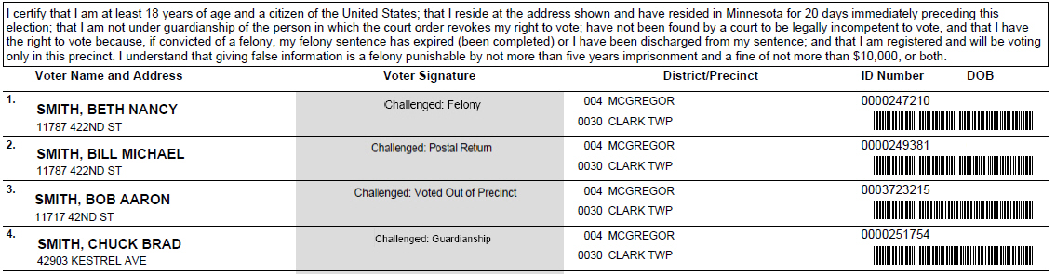
Roster Notations
Address

Slide 13
Common Roster Notations
A.B. or Absentee Ballot
  Voter has already cast an absentee ballot and cannot vote again in person
See ID
  Must show Election Day Registration (EDR) documentation
Challenged – Postal Return (postal verification card was returned)
Challenged – Voted Out of Precinct (provide proof of residence)
Challenged – Address (residency in question)
Challenged – Guardianship (court-ordered guardianship)

Slide 14
Go to Registration Table If…
Submitted registration application less than 20 days before election
Has not voted in past 4 years
On roster but had legal name change
Changed addresses within the precinct
  Even if they have moved to a new apartment within the same building

Slide 15
Can’t find a voter’s name?
Is the voter at the wrong precinct?
Did the voter move out of the precinct?
Was the voter’s name was left off due to clerical error?
  See Emergency Voting Procedures as per M.R. 8200.3800 / Call the City Clerk’s Office
Does the voter’s name, address or date of birth on the roster contain a clerical error?
  Roster correction form
If you need assistance, call the Clerk’s Office

Slide 16
Roster Tips
The roster is a legal document that indicates a voter received and cast a ballot
  Maintain it carefully – DO NOT REMOVE PAGES*!
Keep the roster free of unnecessary handwriting
Avoid using an “x” to identify where a person should provide their signature
Use Roster Correction Forms or Certification Statement of Deceased Voter to note changes/corrections to roster

Slide 17
Registration Steps
Use precinct finder to verify voter is at right polling place
Confirm voter has not already voted absentee
  A list of AB voters will be with your materials
Complete a registration application
Confirm proof of residence
Complete EJ official use only section on bottom
Have voter read oath on the Election Day Registration roster page
Have voter complete and sign the Election Day Registration Roster
Hand them a voter receipt

Slide 18
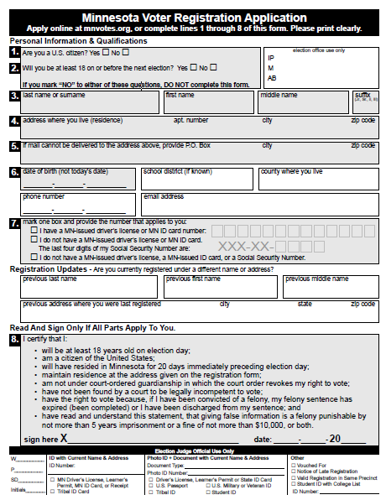
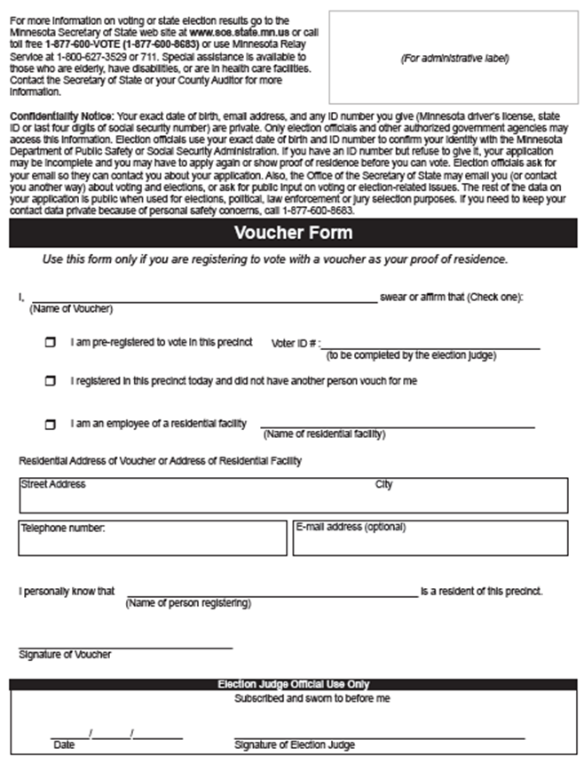
Election Day Registration (EDR or VRA) Application

Slide 19
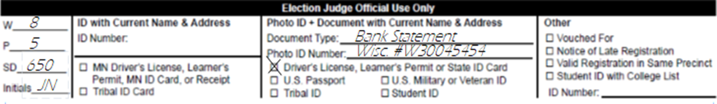
‘Official Use Only’ Section

Slide 20
Eligibility
A U.S. citizen
At least 18 years old on Election Day (may register if at least 16, but cannot vote)
A resident of Minnesota (NOT a specific precinct) for 20 days
A person can vote while under guardianship unless a judge specifically has revoked their right to vote.
A person cannot vote if a court has ruled that they are legally incompetent
A criminal record does not impact your right to vote unless you are currently incarcerated for a felony conviction

Slide 21
What are the valid forms of proof of residence
acceptable for Election Day registration?

Slide 22
1. ID With Current Name And Address
Current Minnesota driver’s license, learner’s permit or ID card
  Receipt for a Minnesota driver’s license, learner’s permit or ID card
    NOT required to show photo ID, receipt alone is sufficient (generally includes a picture now)
Tribal ID with name, current address, signature and picture from federally recognized tribal government
Valid Student ID if student lives on or in the same city as campus

Slide 23
2. Old or Expired ID and a Document With Address
The ID can be expired
The document can be a bill, account or start-of service statement, and must be due or dated within 30 days of the election.
Student fee statement must be for current or next semester
You can also show the document on a phone or other electronic device

Slide 24
2. Old or Expired ID and a Document With Address
Approved old or expired photo ID:
Driver’s license, state ID or learner’s permit issued by any state
U.S. Passport
U.S. Military or Veteran ID
Tribal ID with name, signature and photo
Minnesota university or college ID
Minnesota high school ID

Slide 25
2. Old or Expired ID and a Document With Address
Approved documents (Bills, Account Statements, and Start-of-Service Notifications):
Phone (landline, cell, VOIP, etc.)
TV (cable, satellite, etc.)
Internet
Solid waste or sewer
Electric, gas or water
Banking or credit card
Rent or mortgage payments
Residential lease or rent agreement valid through Election Day
Current student fee statement

Slide 26
3. Vouching (M.S. 201.061, subd. 3(a)(4))
Voter registered in same precinct can sign an oath attesting to up to 8 new registrants’ residence
Assisted living staff members may vouch for residents (includes adult foster care, residential treatment)
Must personally know they live in the precinct
Voucher can also register on Election Day, except by vouching—if they are vouched for, they cannot vouch for others
Complete voucher form on backside of application
  New clarifying language for voucher form: Use this form only if you are registering to vote with a voucher as your proof of residence.
Note on tracking sheet (Precinct List of Persons Vouching form)

Slide 27
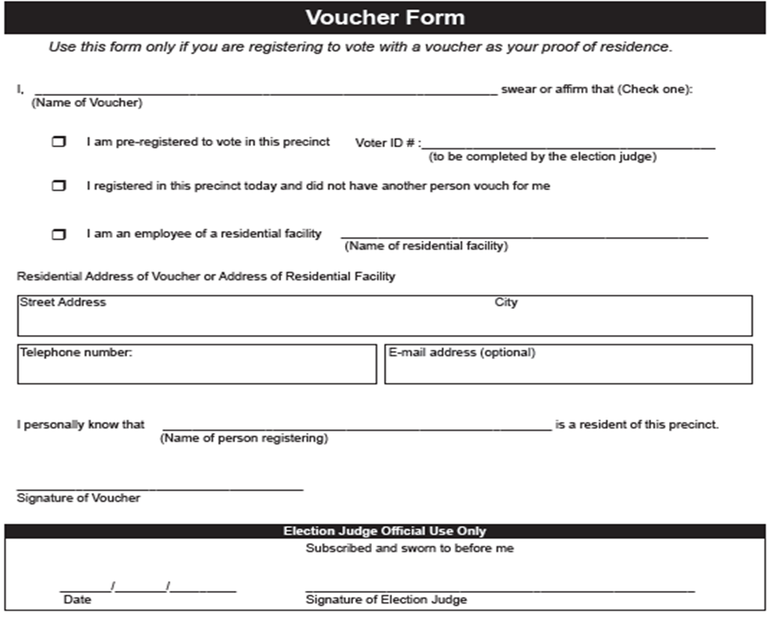
3. Vouching (M.S. 201.061, subd. 3(a)(4))

Slide 28
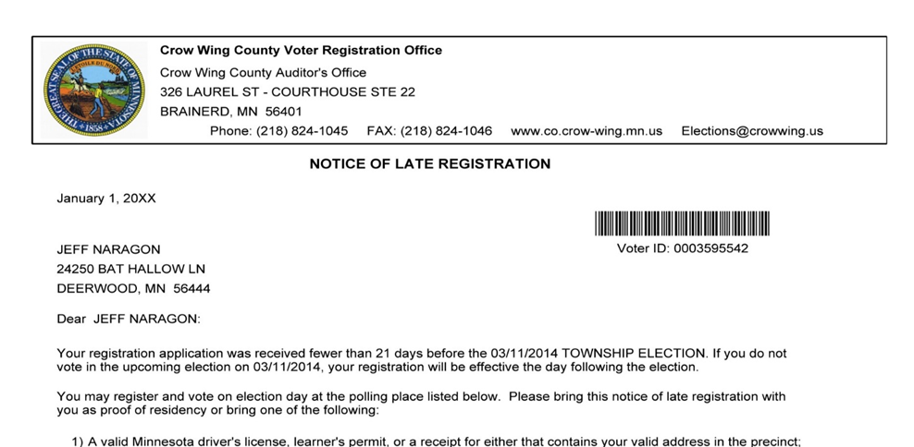
4. Notice of Late Registration
If you registered to vote within 20 days of the election, you may get a Notice of Late Registration in the mail
It can be used as a proof of residence

Slide 29
5. Valid Registration in the Same Precinct
If a voter is currently registered in the precinct but changed names or moved within the same precinct, their registration serves as proof of residence – no additional documentation is needed
Find voter’s name on roster and copy their voter ID number in the ‘other’ section on the bottom of the registration application

Slide 30
6. Student ID with College List
Precinct may be provided with a list of students housed at a Minnesota college or university
Students on list can register by showing a current, valid student photo ID

Slide 31
Don’t Forget to…
Document proof of residence provided on bottom of voter registration application
Have voter complete and sign new registrant roster page
Provide voter receipt and direct to demonstration or ballot judge
Keep running total of persons unable to provide proof of residence

Slide 32
Spoiled and Found Ballots
Spoiled ballot
  Exchange for new ballot and put into spoiled ballot envelope
Found ballot (ballot found abandoned somewhere)
  Mark “found in booth” on ballot and put in spoiled ballot envelope
  Record on incident log

Slide 33
DS-200 Errors
DS200 will beep and return the ballot if:
  Voted for more candidates than is allowed for an office
  Voted for candidates from more than one party in a State Primary
Voter may get new ballot, or you can override the error to vote ballot as is
If DS-200 Stops Working:
  Open auxiliary slot on ballot box and contact the City Clerk’s Office
  Voting continues without interruption
  When counter is working, but ballots in auxiliary slot into ballot counter.

Slide 34
Polling Place Conduct
Incident Log:
  Lets officials know what occurred in the precinct
  Record ANY and ALL unusual events or problems
  Record how problems were resolved
  MUST BE returned to clerk with precinct supplies!!

Slide 35
Persons Allowed In or Near the Polling Place (M.S. 204C.06)
Only election judges, people directly engaged in voting, and authorized persons can be present
  Persons helping a voter
  Children accompanying voters
  Vouchers
  Observers with written authorization from the secretary of state, county auditor or clerk
  Peace officers, if judges request their presence to keep order
  Challengers appointed in writing by a political party or nonpartisan candidate
  Teachers and elementary/high school students, if participating in a mock election that has been authorized by the secretary of state
  Persons making a written complaint
  Media with proper credentials
  People conducting exit polls can be on the premises, but not in the room where voting occurs
If an election judge is present who is NOT assigned to your precinct, call the Clerk’s Office immediately.

Slide 36
Media
Must present photo ID to the Head Judge and either:
  - Media credential
  - Written statement from a local election official
Cannot:
  - Approach within 6 ft. of someone voting
  - Converse with voter while in the polling place
  - Make a list of persons voting or not voting
  - Interfere with the voting process

Slide 37
Prohibition on Campaigning
No campaigning or lingering in or within 100 feet of the building
If polling place is on public property, campaigning not allowed anywhere on the property, even beyond 100 feet
Does not apply to adjacent private property

Slide 38
Prohibition on Displaying Campaign Materials
MN Voters Alliance v. Mansky
Minnesota law prohibits a person from displaying campaign material or inducing or persuading a voter in the polling place.
Campaign material includes:
  the name, likeness, logo, or slogan of a candidate who appears on the ballot;
  the number, title, subject, slogan, or logo of a ballot question that appears on the ballot; or,
  the name, logo, or slogan of a political party represented by a candidate on the ballot.

Slide 39
Prohibition on Displaying Campaign Materials
If a person is displaying campaign material DO THE FOLLOWING:
  Explain that state law prohibits displaying campaign material or inducing or persuading voters in the polling place
  Ask the individual to cover up or remove the material, or to refrain from inducing or persuading other voters
  If they refuse, explain that eligible voters will be allowed to vote, but any refusal will be recorded and referred to the appropriate authorities.

Slide 40
Prohibition on Displaying Campaign Materials
EVEN IF A VOTER REFUSES TO COVER UP OR LEAVE –
YOU MUST PERMIT AN ELIGIBLE VOTER TO VOTE!!
  Record the names and addresses of a voter with a brief description of the campaign material or they way the voter was inducing or persuading another voter
  Election judges and official challengers are prohibited from displaying campaign material, inducing or persuading voters. You can ask them to leave if they refuse to remove the material, or to stop inducing or persuading.

Slide 41
Security Practices
  EJs are the 1st Line of Defense for physical & cyber security of Minnesota’s elections!
  Watchful throughout election day:
    All voting equipment
    Removable memory devices
    Ballots
    Supplies
  Anything suspicious & all incidents, communicated to the local election official immediately
Notes:
Security Practices
Election judges represent the first line of defense for the physical and cyber security of Minnesota’s elections. All election judges must keep a watchful eye on all voting equipment, removable memory devices, ballots & supplies throughout the Election Day. Individuals observed inspecting, assessing or attempting to access or connect a device to voting equipment input/output data ports should be addressed by the head judge (and additional election judges if needed), with the incident communicated to the local election official immediately.

Slide 42
Security Practices
  Good practice to:
    View & inspect seals on all port plugs on all equipment & ballot storage containers.
    Take seriously voter reports of email, text, social media, phone or other communications attempting to disrupt or spread misinformation about the voting process.
  Report to the local election official, immediately, any and all items related to election security!
Notes:
Security Practices
Further, it is good practice to view/inspect the seals and any port plugs on voting equipment & ballot storage containers throughout the day, with concerns again being reported immediately.
Voter reports to election judges of observation of any of the above, or of e-mail, text, social media, phone or other communications attempting to disrupt or influence the elections process should similarly be reported.

Slide 43
Security Practices
  Sergeant-at-arms or peace officer:
    May be requested to arrest or remove from the polling place any individual who, despite a warning to desist, engages in disorderly conduct, to include tampering with voting equipment.
Notes:
Security Practices
A sergeant-at-arms or a peace officer may be requested to arrest or remove from the polling place any individual who, despite a warning to desist, engages in disorderly conduct, to include attempting to tamper with voting equipment.

Slide 44
Security Practices
  Sergeant-at-arms or peace officer:
    Shall not otherwise interfere in any manner with voters.
    A peace officer cannot remain in or within 50 feet of the entrance of the polling place once peace has been restored.
    Note the details of all security concerns & how they were addressed on the incident log
Notes:
Security Practices
A sergeant-at-arms or a peace officer shall not otherwise interfere in any manner with voters. The peace officer cannot remain in or within 50 feet of the entrance of the polling place once peace has been restored.
Note the details of all security concerns & how they were addressed on incident log.
Related statutes & rules: M.S. 204C.06, subds. 5 & 6

Slide 45
Providing Assistance to Voters
Do not influence how a person votes
Direct questions to the voter, not others with them
Help only as much as requested
Two election judges of different major parties may mark a ballot according to voter’s direction
Suggest using the Omni-Ballot first
Do not reveal how they voted

Slide 46
Interpreters and Assistance from Others
Voter may choose someone other than election judges for help
  Except an agent of their employer, their union or a candidate
Assistants can help an unlimited number of voters in all aspects of the voting process, including marking ballots

Slide 47
Curbside Voting (M.S. 204C.15, subd. 2)
Voter unable to enter polling place may vote from their vehicle
Two election judges of different major parties bring voting materials to vehicle.
Do not bring actual roster outside — use the Certificate of Registered Voter form

Slide 48
Challengers: Contesting a Voter’s Eligibility
An election judge, any eligible voter in the precinct, or an appointed challenger may contest a voter’s eligibility
Must have personal knowledge that the person is not eligible to vote
Suspicion is not a basis for making a challenge.
Cannot challenge a voter’s party preference

Slide 49
Challengers: Appointed Challengers (M.S. 204C.07)
Appointed by nonpartisan candidates, political parties, or by jurisdiction holding election on a question
Present letter of appointment and proof of residence used for Election Day registration
Only 1 appointment per party/candidate per precinct

Slide 50
Challengers: Challenger Code of Conduct
Must complete Oath of Challenge Form
Cannot converse with voters
Cannot make list of who voted
Cannot handle election materials
Cannot challenge party preference

Slide 51
Challenge Procedure
Challenged voter swears oath
Election judge questions voter regarding challenge
If voter answers indicate they are eligible, voter signs roster and votes
If the voter refuses to answer questions or sign the roster, they cannot vote
  Cannot come back later in the day and vote
  Make note in Roster on voter’s roster line
Election judge records outcome on Oath of Challenge form

Slide 52
Closing the Polls: Close of Voting
Voters in line at 8 pm must be allowed to vote
DO NOT SHUT DOWN MACHINES BEFORE 8 PM!!
Polling place open to the public after all voting is finished
Members of the public observing closing do not have to provide letter like challengers
GO THROUGH YOUR CHECKLIST!!

Slide 53
Closing the Polls: Close of Voting
FILL OUT THE PINK STATISTICS SHEET!!
Number of Signatures on Roster ≠ Number Ballots in Box?
  Review for excess ballots (more votes than voters)
  If exists, contact clerk/auditor
  If does not exist, proceed
Pack supplies and unused ballots
Seal all used ballots in provided envelopes, ensure ballot box is empty
Deliver election materials indicated on the closing checklist and results to local officials

Slide 54
Tell Your Friends and Family!
Especially this year, we need qualified judges!
Must be eligible to vote in Minnesota and able to read, write, and speak English
Students who are at least 16 years old can be trainee judges
Relatives cannot serve together in the same precinct at the same time
Candidates cannot serve in a precinct where they are on the ballot
Complete an application on the “Be An Election Judge!” page of the City Clerk’s website (www.duluthmn.gov/city-clerk)
Or contact Administrative Information Specialist Robert Shipp at rshipp@duluthmn.gov or 218-730-5257
Thank you all for what you do to help elections run fairly and smoothly!

Slide 55
CONTACTS, ADDITIONAL TRAINING & RESOURCES
City Clerk’s Office: (218) 730-5900 or (218) 730-5500
https://www.sos.state.mn.us/election-administration-campaigns/election-administration/election-judge-training/
2022 Election Judge Guide: https://www.sos.state.mn.us/media/4905/election-judge-guide.pdf
2023 Presidential Nomination Primary Supplemental Guide: https://www.sos.state.mn.us/media/5528/2024-pnp-election-judge-guide-supplement.pdf

