Slide 1
2023 Proposed Budget
City Clerk

Slide 2
Division Overview
2023 Proposed General Fund Expenditures $106,286,500

Slide 3
2022 Budget vs 2023 Budget Expenditures
Notes:
Odd years the City pays for ballots, even years the County pays

Slide 4
FTE’s 2022 vs 2023

Slide 5
Division Overview
Director of Administrative Services
Human Resources
IT
City Clerk’s Office
City Clerk
Assistant City Clerk
City Council
Boards & Commissions
Executive Assistant
Data Practices
Administrative Information Specialist
Administrative Information Technician
Licensing
Elections
Temporary Election Staffing
Code Compliance
Data Practices Compliance Official

Slide 6
Priority Based Budgeting – City Clerk

Slide 7
2022 Budget vs 2023 Budget Revenues
Notes:
ISD 709 Reimbursement every other year for the $10K Miscellaneous Sales

Slide 8
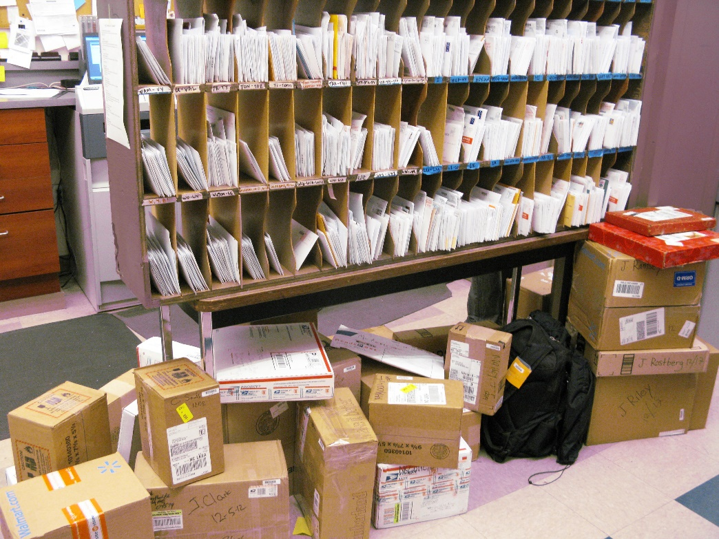
Other Responsibilities of the City Clerk’s Office
Data Practices
Process requests for public data
Approximately 150+ annual requests
City Hall Mail Room
Process all incoming & outgoing mail
60,000+ pieces of outgoing mail annually
Code Compliance
Earned Sick and Safe Time
Conversion Therapy Ban
Plastic Bag Fee
Licensing Enforcement
Public Information & Referral Services
City Hall Use Permits
City Hall Public Posting Inquiries
Licensing & regulatory inquiries
Public Service Inquiries
Maintain various city websites including for the city council, boards and commissions, elections, etc.

Slide 9
City Council Support
Preparing agendas and minutes
Recording & broadcasting meetings in cooperation with PactTV
Coordinating council meeting schedule
Managing council budget
Relaying council correspondences to news media
Overseeing technical upgrades to council chambers
Providing council amenities such as meals, snacks, printouts, nametags, parking passes, etc.

Slide 10
Boards & Commissions
Provide support for 34 city boards and commissions
Coordination of board and commission appointees
Administration of board and commission oaths
Coordination and training of board and commission staffers
Board and commission recruitment
Liaison for Alcohol, Gambling & Tobacco Commission
Liaison for Charter Commission
Board and commission realignment taskforce reporting

Slide 11
Licensing
Licensing Administration
1300+ Business Licenses
350+ Liquor Licenses
1800+ Animal Licenses
40+ Special event permits

Slide 12
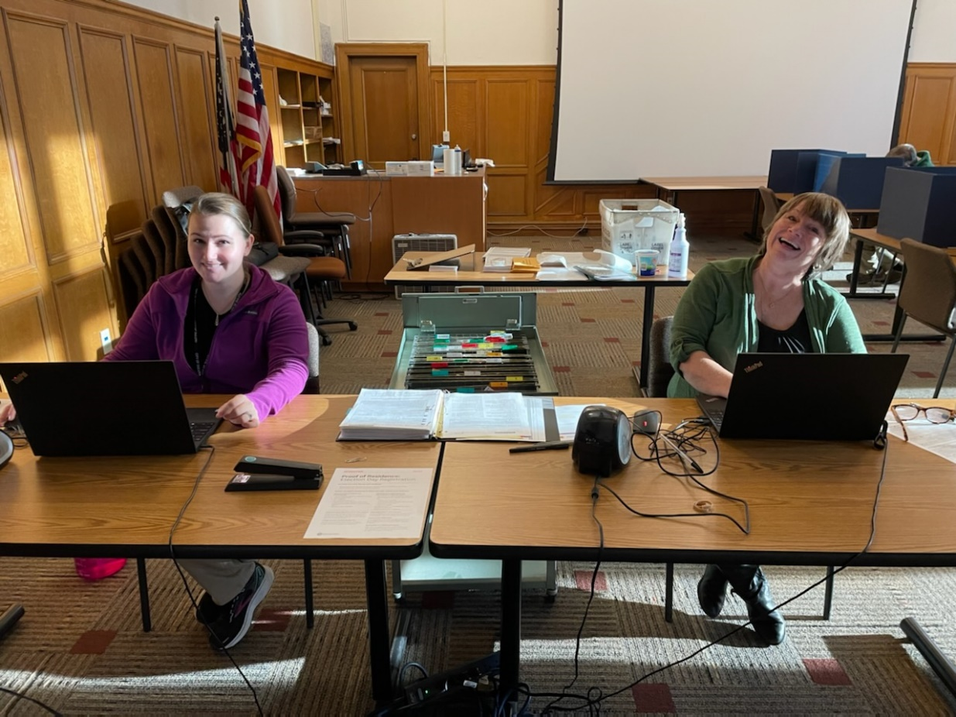
Elections
Redistricting
New Precinct 35;
Early Voting
2016: 6000
2018: 5500
2020: 39,863
2022: 7,335
Election Fun Facts:
We train and schedule over 350 election judges.
Approximate time on each absentee ballot request 7 -12 minutes (from start to finish)
Approximate postage cost per absentee request: $1.70
Approximate cost for each absentee request (staff time, supplies): $13.45
Early voting starts 6 weeks prior to the election
Early voting also takes place on the Saturday prior to elections
We schedule and coordinate with 34 locations across the city for election day voting
Warehouse staff, which tests 40 voting machines and 35 AutoMarks, work for 5 weeks
prior to the election.
Average daily phone calls received by our office during the 2022 election cycle: 35
Staff overtime: 30 - 36 hours for 2022

Slide 13
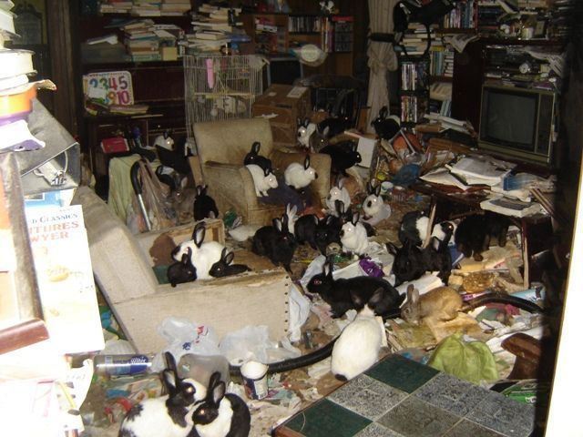
2022 Accomplishments
City Code Chapter 6 Revision
Saved citizens time and money by…
Eliminating “red tape” licensing and regulatory requirements;
Helped protect animals by…
Creating a new registration system for animal rescue groups;
Enabling Duluth Animal Control to more effectively address animal hoarding and abuse;
Re-staffing and re-training
83% turnover in 2022!
All but one employee was either a new hire or promoted internally into a new position!

Slide 14
Opportunities & Challenges
Earned Sick and Safe Time
Labor standards education
Wage Theft
Participation in multi agency labor standards group including MN Dept of Labor, US Dept of Labor, City of Minneapolis, City of Saint Paul, and MN Attorney General’s Office
Licensing Enforcement
Work with DPD’s Professional Standards Unit
New Licensing Software
Online applications & renewals
Electronic payment options

Slide 15
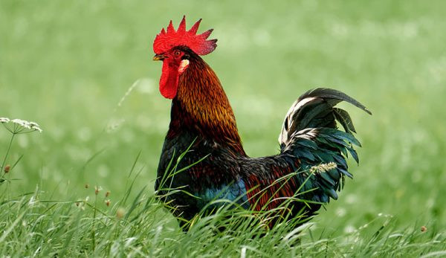
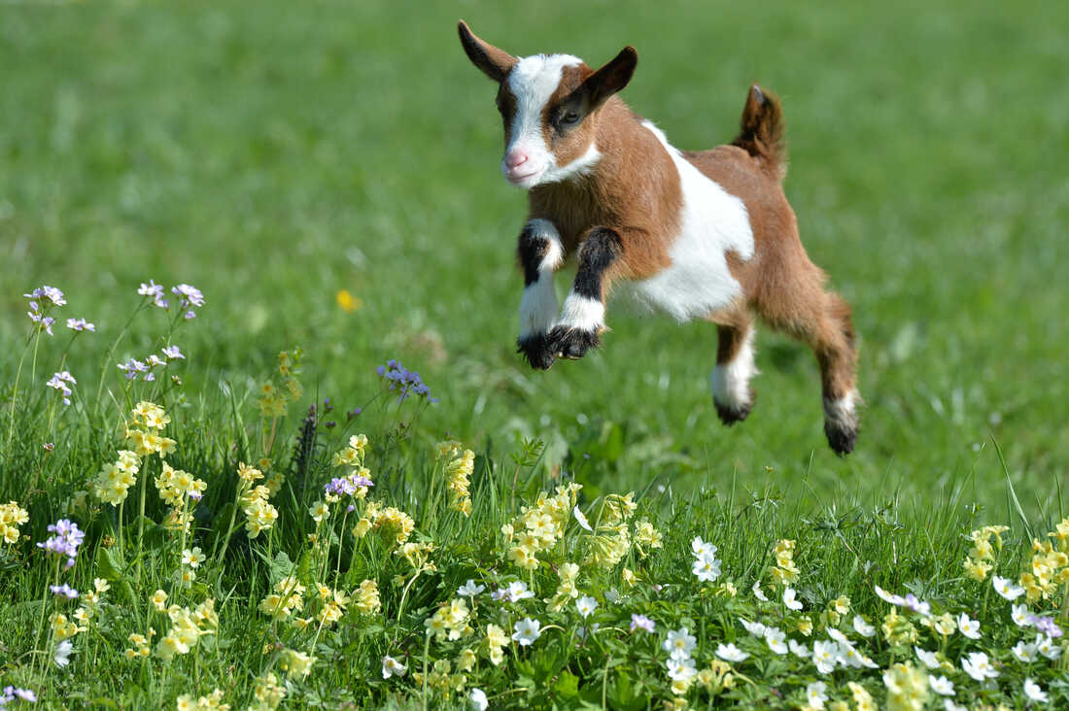
Fun Facts about our Division
We license chickens and inspect their coops for Duluth Animal Control!
We license Goats!

Slide 16
Questions?

