Slide 1
Head Election Judge Training – 2024
St. Louis County Auditor’s Office
100 North 5th Avenue West, Room 214
Duluth, MN 55802
NANCY J. NILSEN, COUNTY AUDITOR-TREASURER

Slide 2
Election Contacts
Nancy J. Nilsen, St. Louis County Auditor-Treasurer
Elections Division
Email: elections@stlouiscountymn.gov
Phone: (218) 726-2385 or Fax: (218) 725-5060
Phil Chapman, Deputy Auditor/Elections Supervisor
Email: chapmanp@stlouiscountymn.gov
Phone: (218) 726-2445
Jon Blevins, Information Specialist III
Email: blevinsj@stlouiscountymn.gov
JoDee Poucher, Information Specialist III
Email: Poucher@stlouiscountymn.gov
Gerhard Von Rabenau, Information Specialist II
Email: nelsonm4@stlouiscountymn.gov

Slide 3
Election Contacts (Continued)
Minnesota Office of the Secretary of State
100 Rev. Dr. Martin Luther King, Jr., Blvd.
180 State Office Building
St. Paul, Minnesota 55155-1299
Toll Free: 1-877-600-8683, opt. 3, opt. 3
Phone: (651) 215-1440
Website: www.sos.state.mn.us

Slide 4
Election Guides
The Minnesota Secretary of State provides election guides that provide relevant election information:
Current guides can be found on the Secretary of State’s website:
https://www.sos.state.mn.us/election-administration-campaigns/election-administration/election-guides/

Slide 5
Duties Before Election Day
Make arrangements for use of polling place.
Verify that judges have received required training.
Coordinate time for judges to meet and set-up the polling place.
Once election supplies and equipment is received:
Verify seals are intact on tabulation equipment.
Review election supplies to ensure you have all materials
Contact the Auditor’s Office ASAP if there are any items missing.
Secure materials and equipment.

Slide 6
Duties Before Election Day
Make sure traffic flow is clear in polling place and privacy needs are met.
Should be a clear path of travel through all parts of the polling place.
What signs are needed to direct voters through the polling place.
Are disability parking spaces clearly marked and designated?

Slide 7
Election Judge Teamwork
Clearly communicate each roles and responsibilities of each election judge.
Follow-up with judge’s to see if they have any questions or need clarification on duties.
Encourage clear and frequent communication.
Let the judges know that you are available for questions at any time.

Slide 8
Opening the Polling Place
For all state primary and general elections, hours for voting at our Unorganized polling locations is 7:00 a.m. – 8:00 p.m. (M.S. 204C.05 Subd.1a)
School district special elections may have different hours.
Reminder - Ensure all election judges have been administered the oath.

Slide 9
Opening the Polling Place
Post voting hours sign on the main entrance where voters will enter.
Post at least two sample ballots that voters can study while in line. One of the sample ballots should be placed at a height that can be easily read by a person seated in a wheelchair.

Slide 10
Opening the Polling Place
Prominently display the Voter’s Bill of Rights.
If voters must walk through the building to enter the voting location, put up signs pointing the way. If the exit is different from the entrance, clearly label the exit.
Ensure parking spots for disabled voters are marked and available.

Slide 11
Opening the Polling Place
Mark the entrance that voters with disabilities can use; if it is not the main door, post easily visible signs pointing the way to the accessible entrance.
If it is necessary for voters with disabilities to take a different route, to avoid stairs for instance, post signs for that accessible route.
Place a United State flag at the entrance of the polling place.
At 7:00 a.m., announce that the polls are open.

Slide 12
Polling Place Reminders
Keep an incident log of any problems, voter complaints or other odd situations that may occur.
Campaign signs are not allowed within 100 ft. of polling place, unless they are on private property.

Slide 13
Polling Place Reminders
ID badges are required to be worn by election judges/clerks in the polling place.
Can be a sticker or something more formal.
NO PARTY AFFILIATION on the badge.
Exit Pollsters
May only ask exiting voters to complete an anonymous survey less than 100 feet from the polling place.
No restrictions if they are more than 100 feet from the polling location.

Slide 14
Polling Place Reminders
Judges should periodically check voting areas for literature and other campaign materials.
Dispose of any campaign materials that are found and log on the incident log.

Slide 15
Polling Place - Reminders
Challengers are allowed in the polling place.
Challengers must be MN residents and make all challenges in writing.
If partisan, need credentials from party.(204C.12) Reminder: Challengers are not there to oversee or criticize election judges.
Their role is to challenge a voter’s eligibility to vote in that precinct, based on their personal knowledge.
Should be documented on the Incident log.

Slide 16
Polling Place - Reminders
News media may enter a polling place with proper credentials or written permission from the local election official.
If media does not have the proper credentials, we can ask them to leave the polling location to retrieve their credentials.
General guidelines:
Must stay 6 feet away from the voters.
Cannot interfere with voting.
Cannot make a list of who is voting.
There is no specific time limit.

Slide 17
General Security Practices
Equipment, ballots, and election materials sticks should be secured and access limited to elections staff.
No one except an election official or and individual who is waiting to register or vote or an individual who is conducting exit polling shall stand within 100 feet of the building in which a polling place is located. (M.S. 204C.06)
Head Judge must grant access to law enforcement.
People refusing to leave a polling location.
People harassing election judges.
Physical threats.
Unplugging or tampering with election equipment.
Tampering with election documents.

Slide 18
Election Judge – Oath
Election Judges must be administered and sign the oath before assuming the duties of the office.
If there is no individual present who is authorized to administer oaths, the election judges may administer the oath to each other.
Oath shall be attached to the summary statement of the election returns of that precinct.
(M.S. 204B.24)

Slide 19
Voting Systems – Assisted Voting Devices
Federal Election law requires all polling places to be equipped with assistive voting devices (OmniBallots).
OmniBallot machines assist the voter in marking the ballot, they do not tabulate ballots.
Must be accessible and available for public use.

Slide 20
DS200 Operation
The preliminary and public accuracy tests will be completed by St. Louis County for Unorganized Townships prior to the delivery of the DS200 machine.
Preliminary and public accuracy tests for all other precincts are conducted by the township or city clerk.
A blue seal will be placed where the results thumb drive is inserted into the tabulator.
Verify that the seal is intact
If not, contact the Auditor’s Office or your jurisdictions clerk ASAP

Slide 21
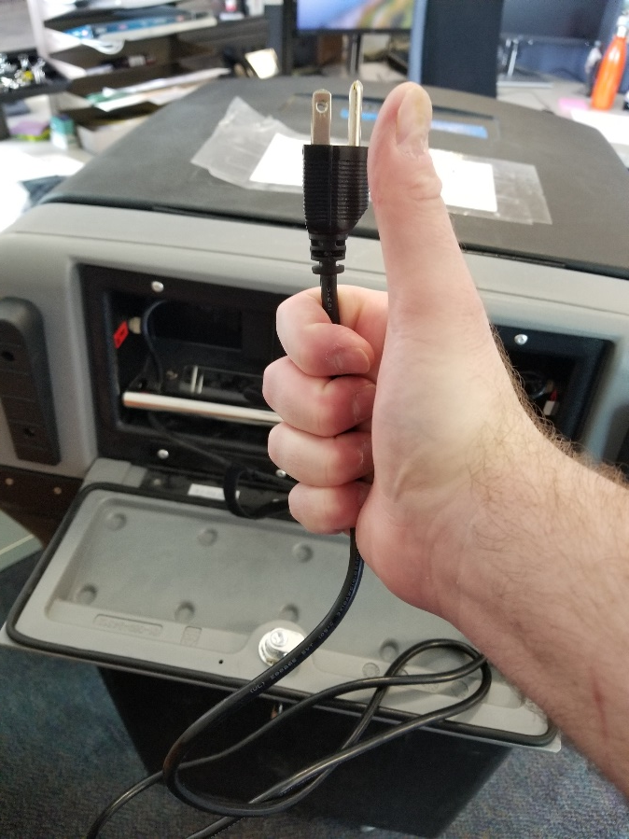
1. Plug it in
DS200 Operation

Slide 22
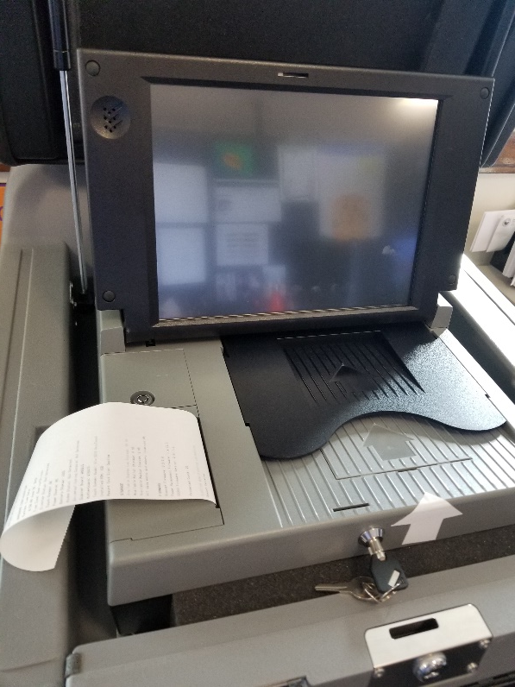
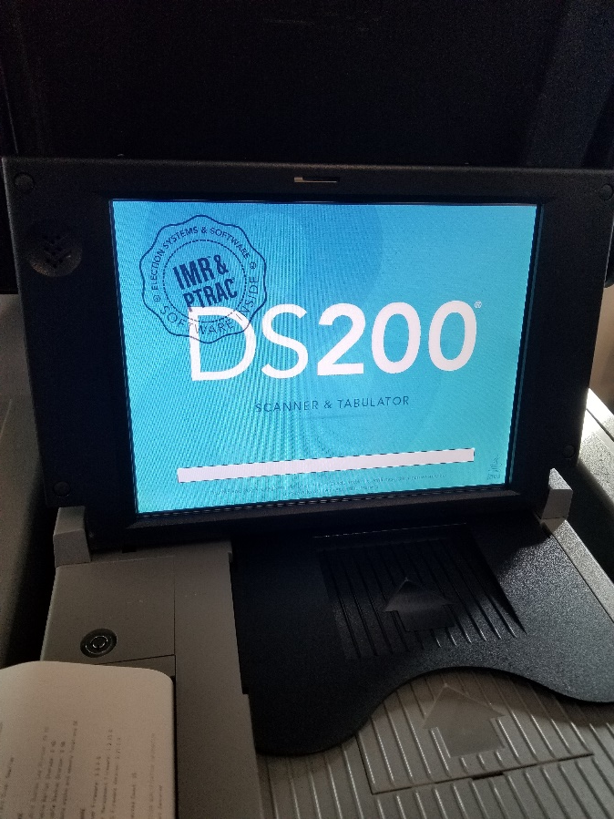
2. Power it on
DS200 Operation

Slide 23
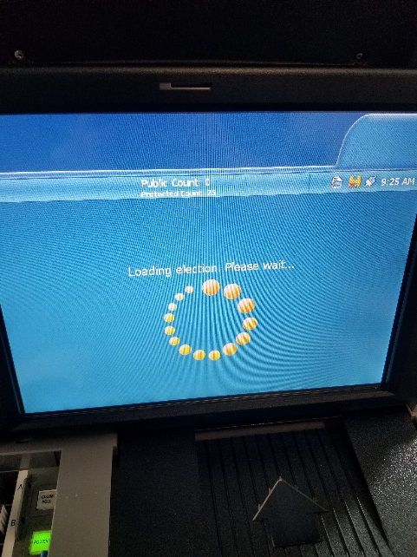
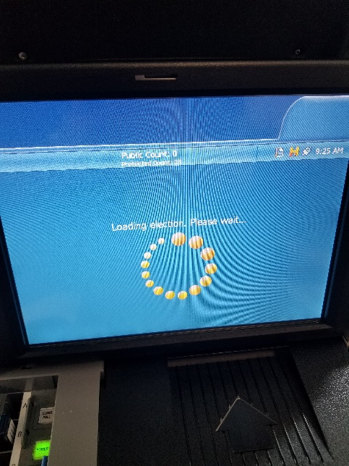
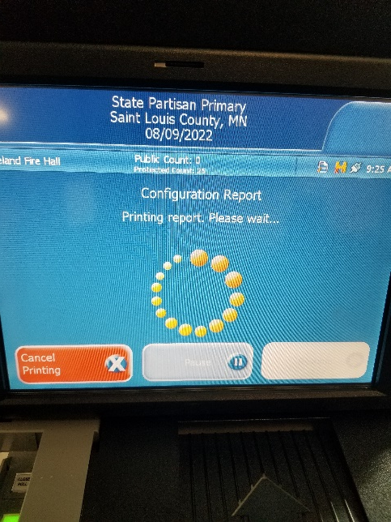
2. Enter password; wait…
DS200 Operation

Slide 24
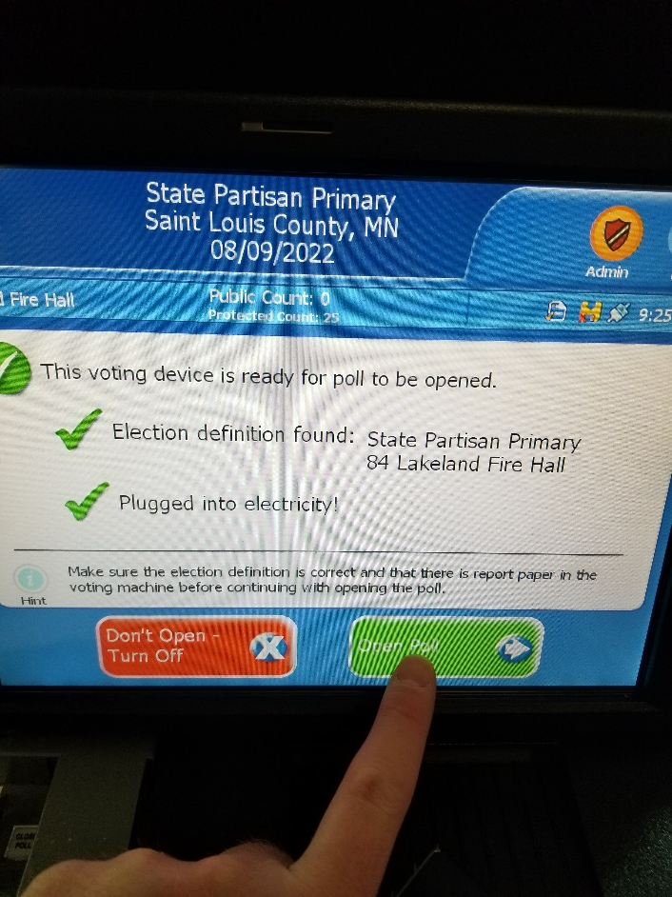
3. Open Polls!
DS200 Operation
Confirm that the election is correct!

Slide 25
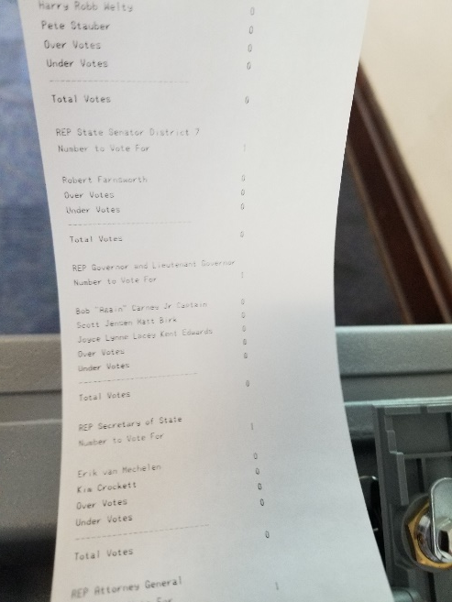
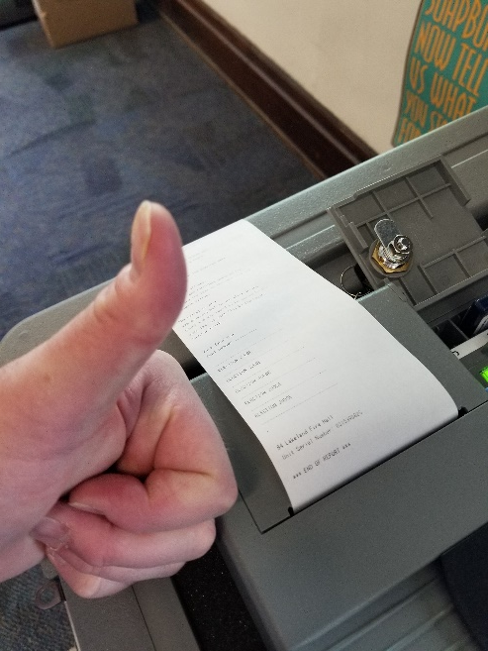
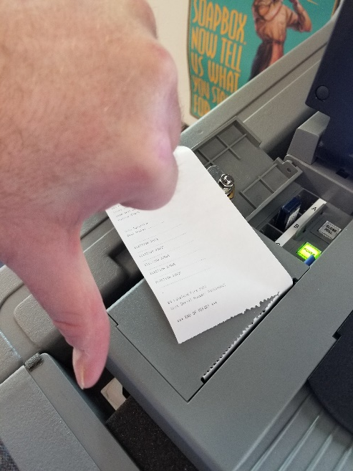
4. Print ZERO TAPE
DS200 Operation
Confirm 0 votes.
Leave attached. DO NOT REMOVE!

Slide 26
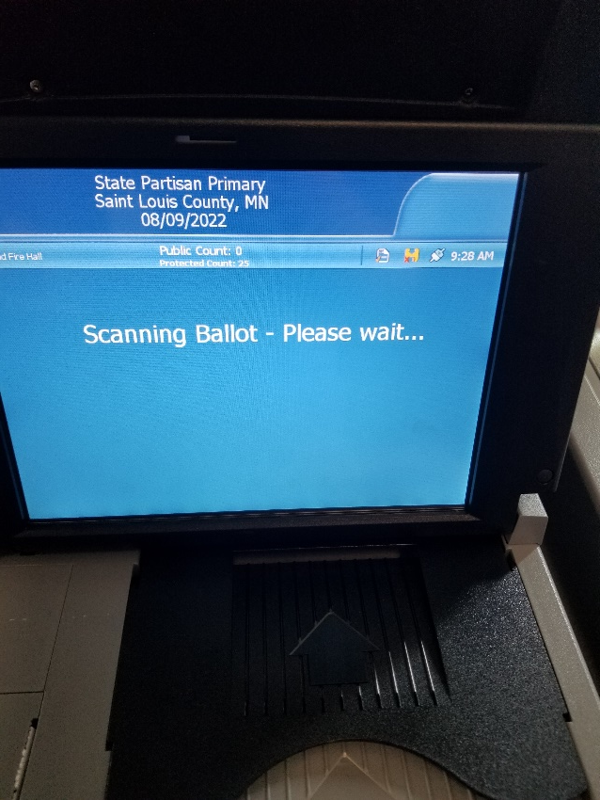
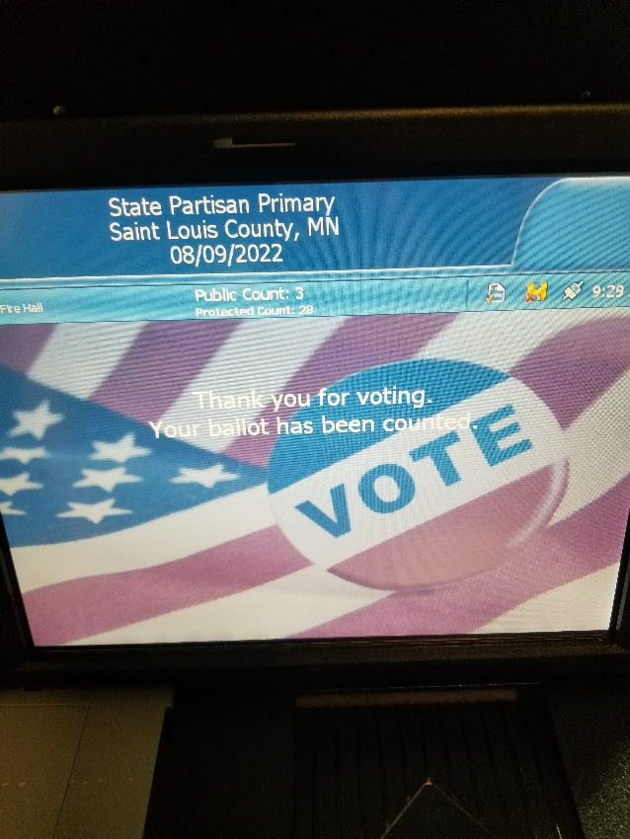
5. Polls are ready for voting
DS200 Operation

Slide 27
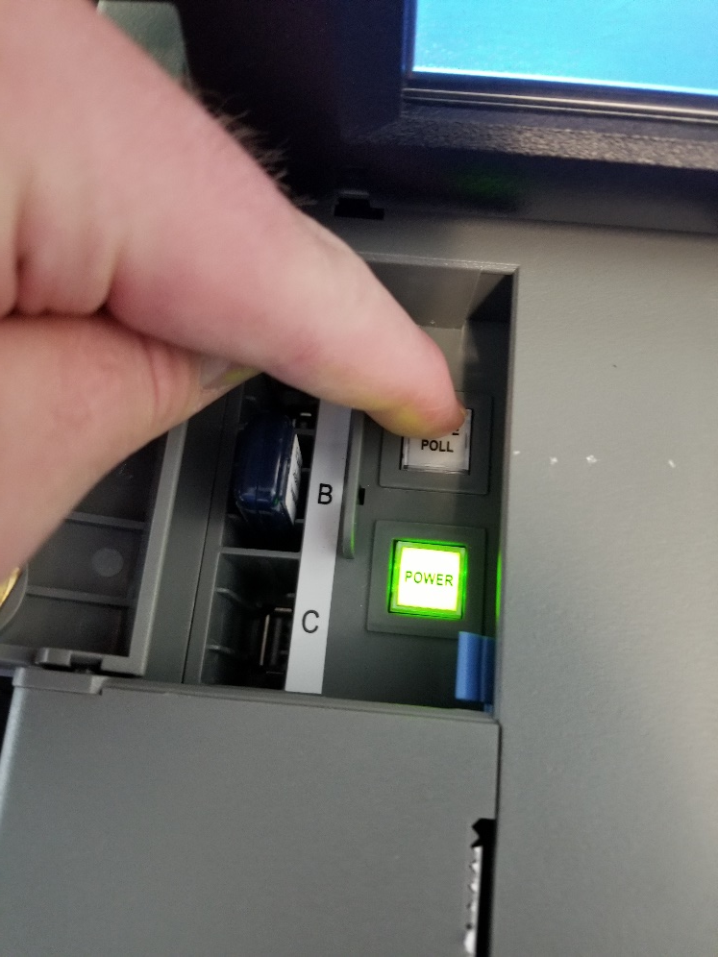
6. Closing the polls
DS200 Operation
CLOSE POLL, not POWER.
Press me!
Not me!

Slide 28
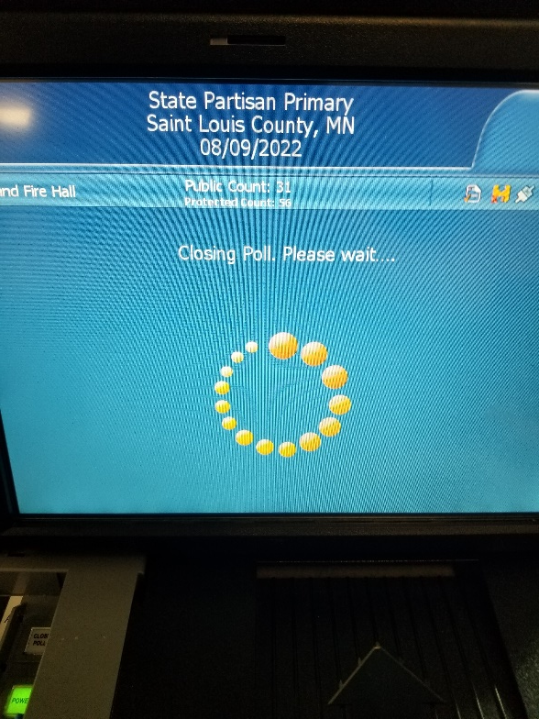
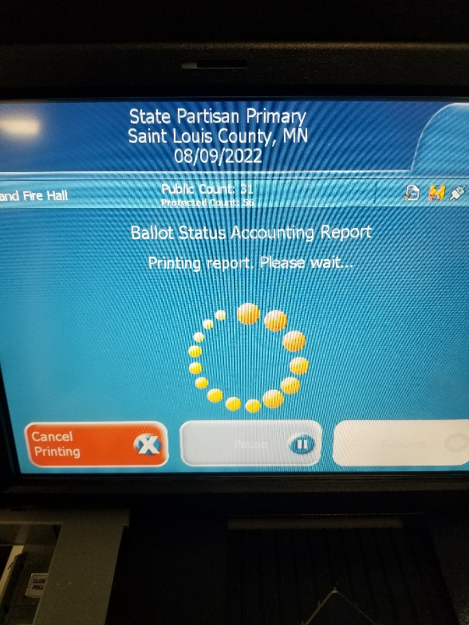
7. Confirm and print reports
DS200 Operation

Slide 29
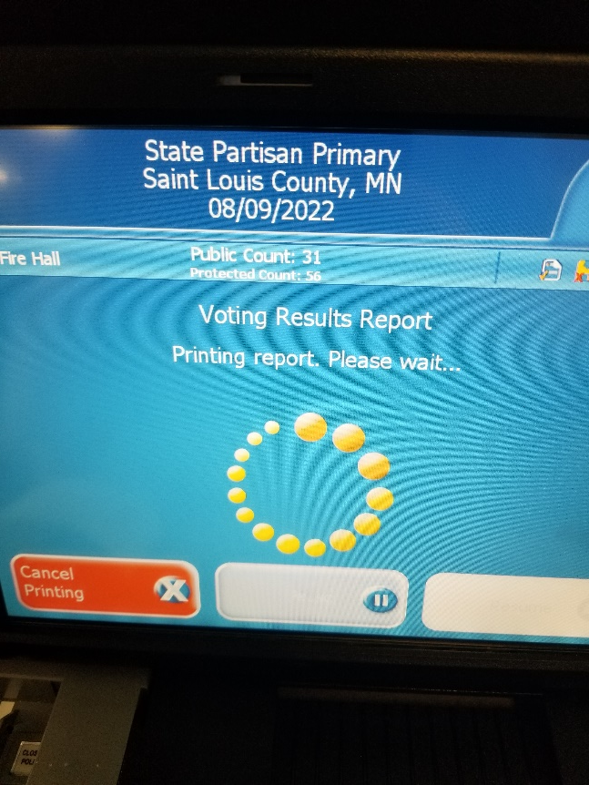
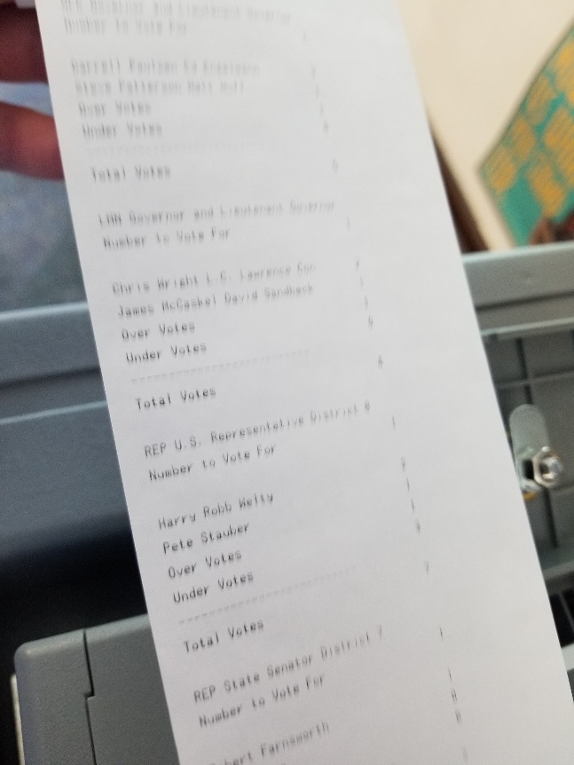
8. Status and Results Reports
DS200 Operation
You’ll print 3 of me!

Slide 30
9. Polls Closed Confirmation
DS200 Operation
Re-open Poll = Resume voting!
Report Options = Print or reprint reports
Finished-Turn Off = Shut down the machine**
** DO NOT PRESS THE POWER BUTTON

Slide 31
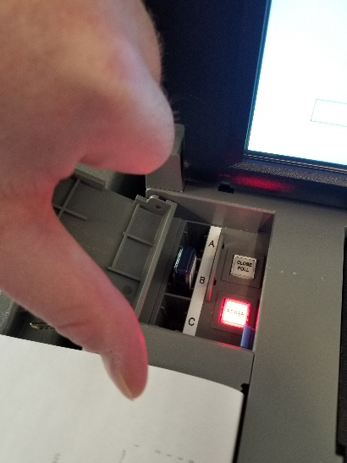
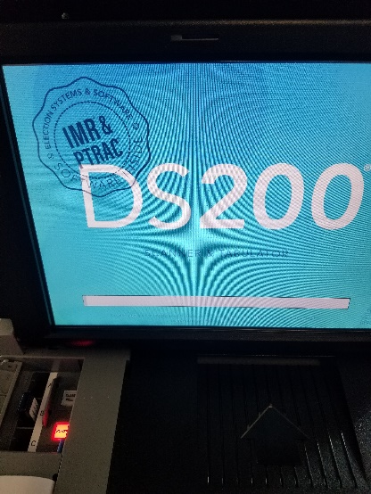
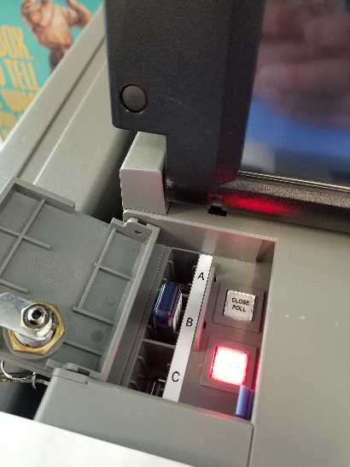
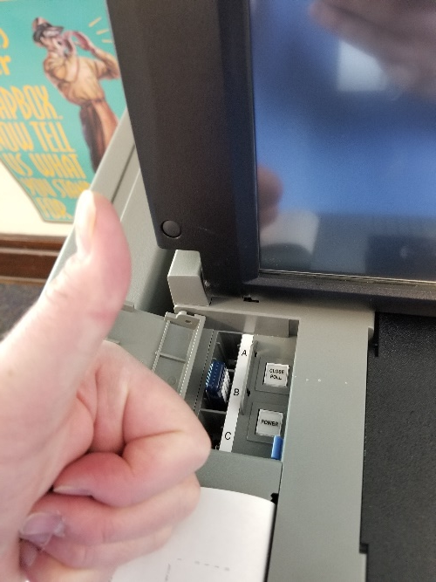
10. DON’T PRESS THE POWER BUTTON
DS200 Operation
Red means STOP!
Do not press the power button.
Wait for machine to power down and light to turn off on its own.

Slide 32
11. Remove Results Drive
DS200 Operation
ONLY remove the drive from the machine once polls have been closed and the system is powered down.

Slide 33
FAQ – Types of Drives
DS200 Operation
EQC
Election Qualifying Card, used to load the election onto the machine. One-time use per DS200.
RESULTS
Your official Election Day drive. Use this for official results tabulation!
BACKUP
Your backup drive. Remember, red means STOP. This drive is ONLY to be used in the event your RESULTS drive does not work. Notify us if your results are on the BACKUP drive.

Slide 34
FAQ - Passwords
DS200 Operation
Passwords are unique to each election and each county
The passwords will be provided to the Clerks in advance of the election
The passwords should only be shared with election judges and deputized staff

Slide 35
FAQ – Two Counts?!
DS200 Operation
What’s the deal with Public Count and Protected Count?
Public Count is the number of ballots tabulated for the current election. This should be 0 when the polls open.
Protected Count is a hard-coded security measure that tracks how many ballots have been run through any given DS200 machine over the lifetime of the machine. Minnesota does not require this, but many other states do.
PLEASE make sure your judges understand the distinction. We anticipate many voter questions about “Protected” count.

Slide 36
Cleaning Procedures – Election Equipment
Required Supplies: Soft, lint-free cloth, Isopropyl alcohol.
To clean the interactive touch screen of the device:
Lightly dampen (do not soak) a soft, lint-free cloth with Isopropyl alcohol.
Using gentle pressure and circular motions, wipe the center of the touch screen surface until clean. Be careful not to scratch the touch screen.
Avoid the edges of the touch screen.
Do NOT use full-strength, harsh detergents, liquid cleaners, aerosols, abrasive pads, scouring powders, or solvents, such as benzene, unless otherwise noted. Disinfectant sprays, such as Lysol, are not permitted and will damage the touch screen.
Do not allow cleaning solutions to come in contact with ballot stock.
Caution Liquids should never be applied directly to the unit. Do not soak the cloth with solution so that moisture drips on or lingers on the external surface.

Slide 37
Election Judge Qualifications
Must be eligible to vote in Minnesota.
Does not have to be a registered voter.
Not required to reside in precinct they are serving as an election judge.
Able to read, write and speak English.
Appointed by the appointing authority (city, township or county).
Trained and certified as an election judge.
(M.S. 204B.19, Subd. 1 & 2)

Slide 38
Election Judge Qualifications
Individuals not qualified to be election judges:
Cannot be the spouse, parent, step-parent, child, stepchild, sibling or stepsibling of a candidate or another judge in the same precinct.
Election Judges who are related to each other can work in the same precinct provided they work separate shifts that do not run concurrently or overlap.
Cannot live with any candidate on the ballot (either permanently or temporarily).
Cannot be a candidate at that election.
(M.S. 204B.19, Subd. 1 & 2)

Slide 39
Election Judge – Party Balance Requirement
At least two election judges in each precinct must be affiliated with different major political parties.
No more than half of the election judges in a precinct may be members of the same major political party.
Exception - If the election board consists of an odd number of election judges:
Election judges who are members of the same major political party may be one more than half the number of election judges in that precinct.
(M.S. 204B.19)

Slide 40
Party Balance Examples
1. Six (6)election judges are serving in polling place A.
Three (3) of the election judges are Republican
Two (2) of the election judges are DFL
One (1) of the election judges are Legal Marijuana Now.
Is the polling place party balanced?

Slide 41
Party Balance Examples
1. Six (6) election judges are serving in polling place A.
Three (3) of the election judges are Republican
Two (2) of the election judges are DFL
One (1) of the election judges are Leal Marijuana Now.
Answer: This polling place is party balanced. At least two (2) judges are from different major political parties. No more than half of the total judges are from the same party.

Slide 42
Party Balance Examples
2. Six (6) election judges are serving in polling place B.
Four (4) of the election judges are DFL
One (1) of the election judges is Republican
One (1) of the election judges has signed a statement that they are “unaffiliated” with a major political party
Is the polling place party balanced?

Slide 43
Party Balance Examples
2. Six (6) election judges are serving in polling place B.
Four (4) of the election judges are DFL
One (1) of the election judges is Republican
One (1) of the election judges has signed a statement that they are “unaffiliated” with a major political party
Answer: This polling place is not in party balance. There’s an even number of judges and more than half of the total judges are from the same party.

Slide 44
Party Balance Examples
3. Seven (7) election judges are serving in polling place C.
Four (4) of the election judges are DFL
Two (2) of the election judges are Republican
One (1) of the election judges has signed a statement that they are “unaffiliated” with a major political party
Is the polling place party balanced?

Slide 45
Party Balance Examples
3. Seven (7) election judges are serving in polling place C.
Four (4) of the election judges are DFL
Two (2) of the election judges are Republican
One (1) of the election judges has signed a statement that they are “unaffiliated” with a major political party
Answer: This polling place is party balanced. At least two (2) judges are from different major political parties.
More than half of the total judges are from the same party. Because the precinct contains an odd number of judges, election judges who are members of the same major political party may be one more than half the number of election judges in that precinct.

Slide 46
Party Balance Examples
4. Five (5) election judges are serving in polling place D.
One (1) of the election judges is Grassroots-Legalize Cannabis Party
One (1) of the election judges is Republican
Three (3) of the election judges have signed statements that they are “unaffiliated” with a major political party
Is the polling place party balanced?

Slide 47
Party Balance Examples
4. Five (5) election judges are serving in polling place D.
One (1) of the election judges is Grassroots-Legalize Cannabis Party
One (1) of the election judges is Republican
Three (3) of the election judges have signed statements that they are “unaffiliated” with a major political party
Answer: This polling place is party balanced. At least two (2) judges are from different major political parties. No more than half of the total judges are from the same major political party.

Slide 48
Party Balance
At the minimum, two election judges must be affiliated with two different major political parties.
Do not suggest to election judges to “switch their major party affiliation.

Slide 49
Election Judge – Polling Place Staffing
Minimum 4 election judges shall be appointed for each precinct in a state election.
Minimum of 3 election judges for precincts with fewer than 500 registered voters of 14 weeks before the state primary.
Election Judge trainees are not counted towards the minimum number of election judges.
(M.S. 204B.22)

Slide 50
Election Judge – Vacancies
Vacancies occurs when an election judge:
Fails to arrive at the polling place within 30 minutes after the time when the polling place is scheduled to be open.
Is unable to perform the duties of the office.
Fails or refuses to perform the duties of the office as assigned by the Head Election Judge.
(M.S. 204B.24)

Slide 51
Election Judge – Vacancies
When a vacancy occurs:
Remaining election judges of the precinct shall elect an individual to fill the vacancy.
The oath signed by the new election judge shall indicate that the new election judge was elected to fill a vacancy.
The Municipal Clerk may assign election judges to fill vacancies as they occur.
(M.S. 204B.24)

Slide 52
Emergency Training
Emergency Training:
Head Judge is responsible for emergency election judge training.
With the time allotted, train on basic duties they may perform.
Use election guide as resource when necessary.
(M.S. 204B.24)

Slide 53
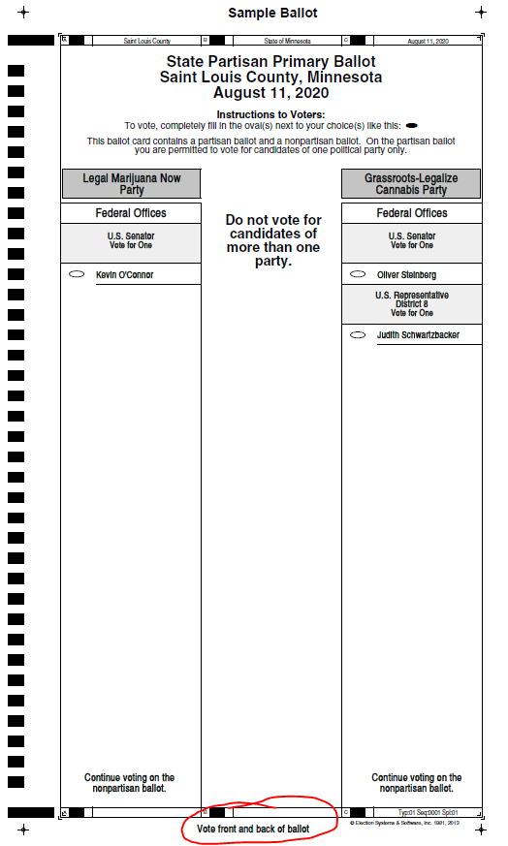
Election Judge Training - Ballots
Make sure to communicate to voters when the ballot has two sides

Slide 54
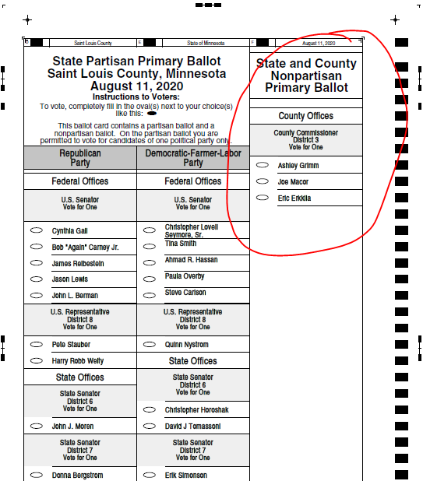
Election Judge Training - Ballots
If there are two sides to a ballot:
County, local, school districts, etc. will be on the back of the ballot.

Slide 55
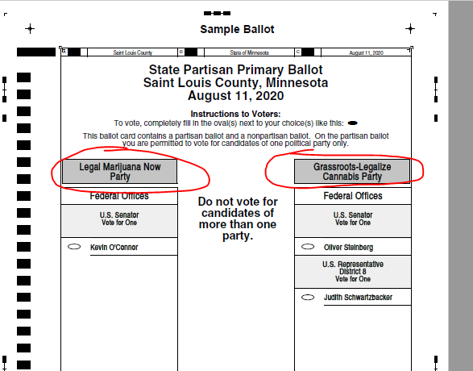
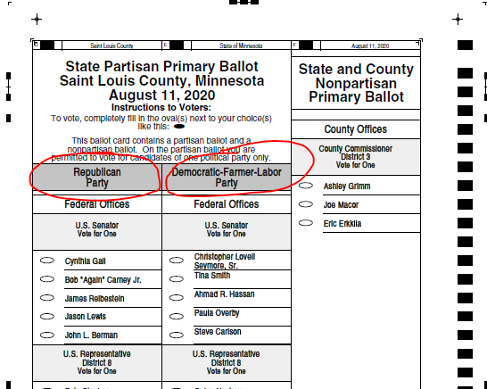
Election Judge Training - Ballots
There are four major parties
Democratic-Farmer-Labor Party (DFL)
Grassroots-Legalize Cannabis Party
Legal Marijuana Now
Republican Party
For State Offices or higher, the voter will only vote for one party in the Primary election.

Slide 56
HAVA Complaint Forms
If a voter wishes to file a complaint about a voter registration issue, voting machine standards, or posting of required information at the polling place have them fill out a HAVA Election Complaint Form.
The voter or the clerk may forward the complaint to the Secretary of State. It is the voter’s option how to submit the complaint.
The judges and clerk should be aware about the circumstances and inform our office of the issue and steps that were taken to resolve the issue.
Document the issue on the Incident log.
(M.S. 200.04)

Slide 57
Other Types of Complaints
Complaints regarding violation of Minnesota election law.
Must complete the Minnesota State Election Law Complaint Form.
The form must be notarized and returned to the County Attorney for investigation.
Complaints regarding violations of the Campaign Finance and Public Disclosure.
Must complete a Complaint for Violation of the Campaign Finance and Public Disclosure Act form.
The form is sent to the Campaign Finance & Public Disclosure Board.

Slide 58
Write-In Votes
Local offices – All write-in votes must be counted.
County Offices and higher
Candidates for federal, state or county office who want their write-in votes counted must file a written request with the filing officer no later than the seventh day before the general election.
Auditor’s Office will forward write-in tally sheets containing names of candidates who filed a request.
Do not count names other than registered write-in candidates.

Slide 59
Election Night Results
It is important to get accurate results to the Auditor’s Office as soon as possible on election night.
Reconcile numbers before closing polls and reporting the results. (Voter receipts = signatures on roster = number of voted ballots)
If the numbers do not balance, election judges must resolve the issue before sending to the Auditor’s Office.
If questions/problems arise, always contact our office for assistance – NEVER GUESS!

Slide 60
Election Night Results
Hand Count Precincts
You must call-in, fax, or e-mail your results ASAP to the Auditor’s Office.
If you are faxing your results, make sure the judges call to confirm receipt before leaving for the night.
Optical Scan/Machine Precincts
You must bring your DS200 sticks to your designated location.
Duluth, Hibbing, and Virginia are drop-off sites for DS200 sticks
Do not call, fax, or email results

Slide 61
Postelection Materials
Summary Statements
Hand count precincts will receive 3-part carbon summary statements with their election supplies.
Machine precincts will use the tapes from their ballot tabulator (DS200 precincts).
When completing the summary statements, all information/totals must be filled out.
Election Judges must sign all copies.
One copy MUST be posted at the polling place.

Slide 62
Postelection Materials – A, B, C Envelopes
Envelope “A”- The tape with the zero tape attached or the first page of the carbon summary statement.
Envelope “B” - The second machine tape or the second page of the carbon summary statement.
Envelope “C” - The third machine tape or the third page of the carbon summary statement.
This is your copy – do not return with election materials.

Slide 63
Postelection Materials
Rosters are legal documents. The entire roster (including blank pages) must be returned.
Rosters must be returned in page number order.
Do not to use blank roster pages as scratch paper.
Place all voted ballots in the Voted Ballot Envelope.
Nothing else should be placed in the Voted Ballot Envelope.
Important - The Voted Ballot Envelope must be sealed and election judges must initial / sign over the seal.

Slide 64
Postelection Materials
Election Day Voter Registrations.
Critical that all Election Day Voter Registrations are returned to us.
Incident log – every precinct must return an incident log
If there were no incidents, simply note that there were no incidents and sign.
Note if there were challengers in the precinct.
Make sure your precinct name is written on the incident log
List of persons vouched for list.
All other ballots i.e. spoiled, those that duplicates were made for, and unvoted ballots.
Signature/certification of returned ballots.
All election thumb drives.

Slide 65
Postelection Materials
Return supplies to the County Auditor or assigned drop location the day after the election.

Slide 66
Postelection Materials
The County Auditor’s Office has strict deadlines for validating vote totals, preparing canvassing information, keying new voter registrations, and scanning voting history.
Jurisdictions with incomplete or missing information/documentation will be contacted with the expectation that the jurisdiction provides the requested information to the Auditor’s Office immediately.

Slide 67
Thank You!
Thank you in advance for all of your hard work and dedication to help make elections successful in St. Louis County!

